Slide 1
Stata class 2: Bias-variance trade-off and basic model selection
Econ 441, Fall 2019

Slide 2
Stata recap
Stata class 2

Slide 3
Steps to take at the beginning
Download the data file(s) to a directory \\...\Stataclasses
Get the path of the directory (go there, click on the little orange/yellow ‘maps’ icon, the path automatically highlighted), copy it to the clipboard (press Ctrl+C)
Write ‘cd’ (=change directory) to Stata, hit space and paste the path of your directory (with Ctrl+V)
Start logging with ‘log using your_filename, t’
Open the data set with ‘use your_dataset.dta’
If you have used Stata beforehand, you may have to add ‘, replace’ as an option (to let Stata know it can delete the old data set in the memory)

Slide 4
Commands we use today
Command + syntax | Explanation
use your_dataset.dta | Open the ‘your_dataset.dta’ data set in Stata’s current working dictionary
summarize variable1 variable2 | Get basic descriptive statistics (mean, std. dev., min, max) of ‘variable1’ and ‘variable2’
regress lhs_var rhs_var1 rhs_var2 | Regressing ‘lhs_var’ on ‘rhs_var1’ and ‘rhs_var2’ variables (multivariate regression estimation with OLS); note the ordering of the variables in syntax!
generate new_var_name= expression(var1) | Generating a new variable named ‘new_var_name’ by transforming the variable ‘var1’ (for us: log(var1) or var1^2)
estat ic | After running ‘regress’, getting the corresponding BIC and AIC (information criteria for model selection)

Slide 5
Bias-variance trade-off
Stata class 2

Slide 6
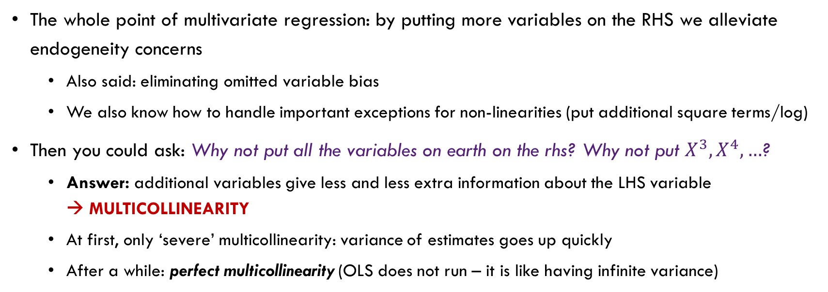
Bias-variance trade-off
The whole point of multivariate regression: by putting more variables on the RHS we alleviate endogeneity concerns
Also said: eliminating omitted variable bias
We also know how to handle important exceptions for non-linearities (put additional square terms/log)
Then you could ask: Why not put all the variables on earth on the rhs? Why not put $X^{3},X^{4},…$?
Answer: additional variables give less and less extra information about the LHS variable → MULTICOLLINEARITY
At first, only ‘severe’ multicollinearity: variance of estimates goes up quickly
After a while: perfect multicollinearity (OLS does not run – it is like having infinite variance)
LESS RHS VARIABLES
Higher omitted variable bias
Lower variance
vs.
MORE RHS VARIABLES
Decreased omitted variable bias
Increased variance

Slide 7
Basic Model selection
Stata class 2

Slide 8
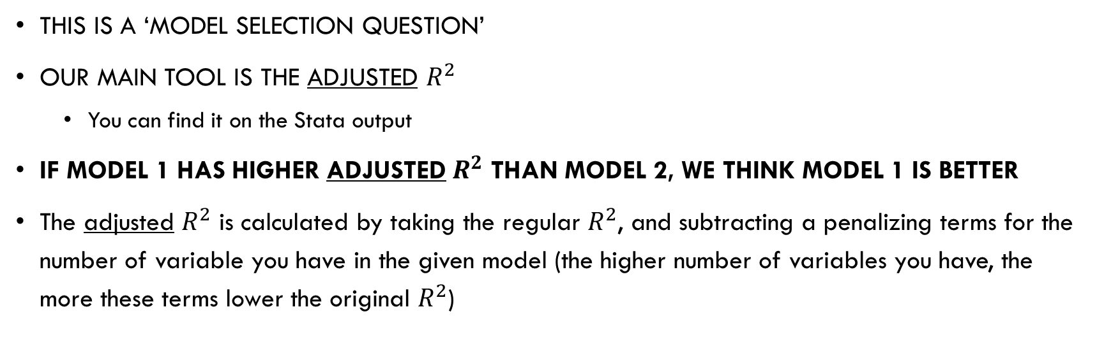
How to decide how many rhs variables are enough?
This is a ‘model selection question’
Our main tool is the adjusted $R^{2}$
You can find it on the Stata output
If model 1 has higher adjusted $R^{2}$ than model 2, we think model 1 is better
The adjusted $R^{2}$ is calculated by taking the regular $R^{2}$, and subtracting a penalizing terms for the number of variable you have in the given model (the higher number of variables you have, the more these terms lower the original $R^{2}$)

Slide 9
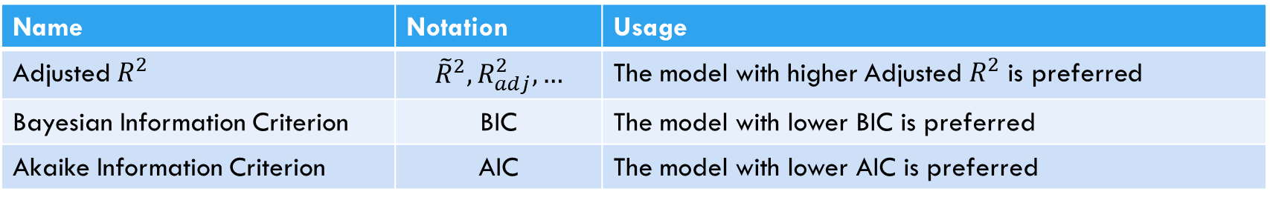
Optional: More model selection criteria
There is a whole zoo of model selection criteria out there
Each have strengths and weaknesses
With AIC for example, you can potentially ‘decide’ between the log vs no-log question!
Caution: while these are useful to strengthen your confidence in your modeling decisions, do not maximize/minimize them blindly
Name | Notation | Usage
Adjusted $R^{2}$ | $${\tilde{R}}^{2}, R_{adj}^{2},…$$ | The model with higher Adjusted $R^{2}$ is preferred
Bayesian Information Criterion | BIC | The model with lower BIC is preferred
Akaike Information Criterion | AIC | The model with lower AIC is preferred
After running ‘regress’, get them by ‘estat ic’

